Slide 1
Truck Platooning
By Agartha
Tural Hasanov - 7216787
Rahim Hashimov - 7216405
Veli Ates - 7213717
Seda Sensoy - 7216627

Slide 2
Agenda
Introduction
Scenario
Use Cases
State Machines
Control Behavior
Architecture
Data Model
Implementation
Simulation
Flow
Results
Summary

Slide 3
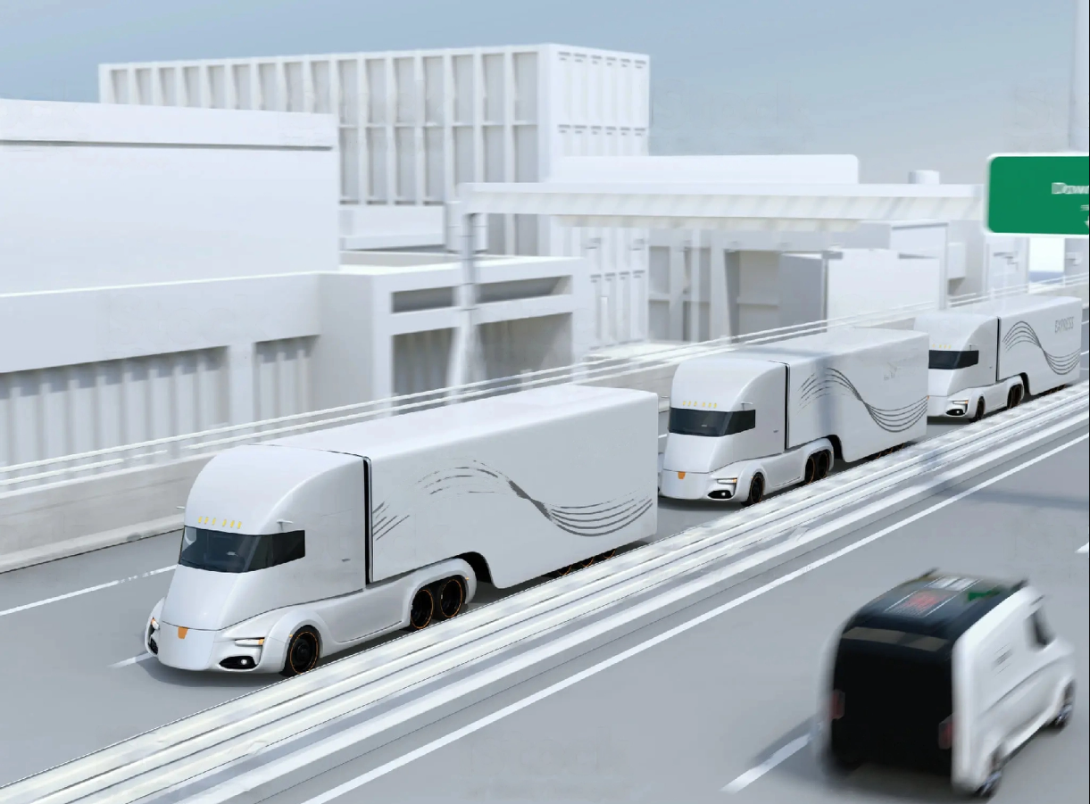
Introduction
A group of trucks travel closely together in a convoy, typically with the lead truck driven by a human driver and the following trucks being partially or fully automated.

Slide 4


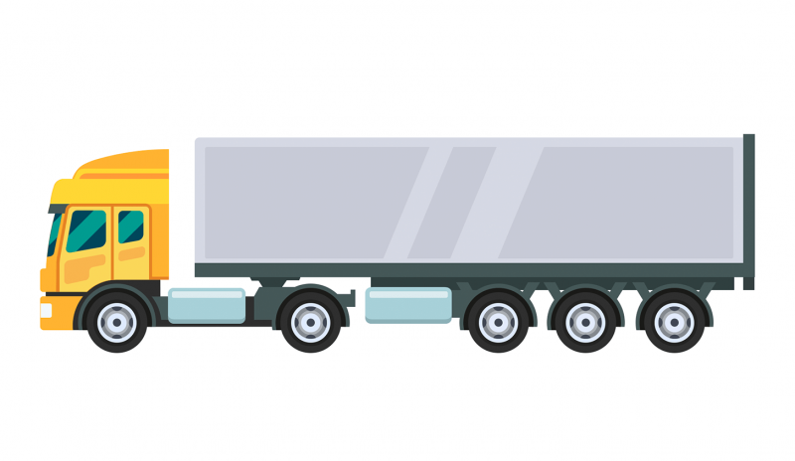


Scenario
V
V2V Communication
Manual Driving
Autonomous Driving
Autonomous Driving

Slide 5
Use Cases
Platoon Formation
Engaging to Platoon
Platooning
Disengage Platoon
Steady State Platooning
Emergency Breaking
Gap Adaptation

Slide 6
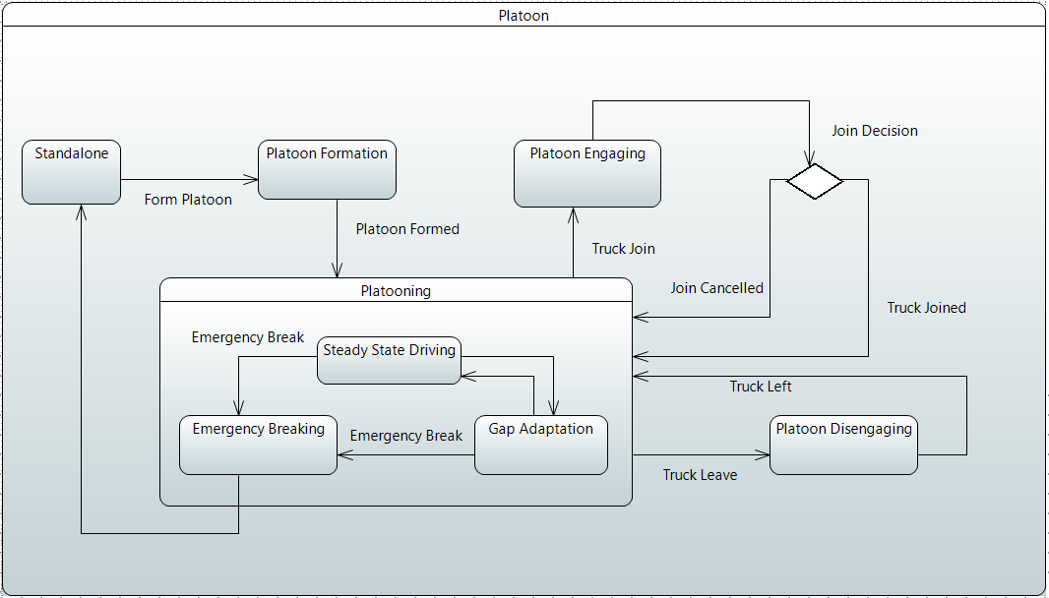
State Machines - Platoon State

Slide 7
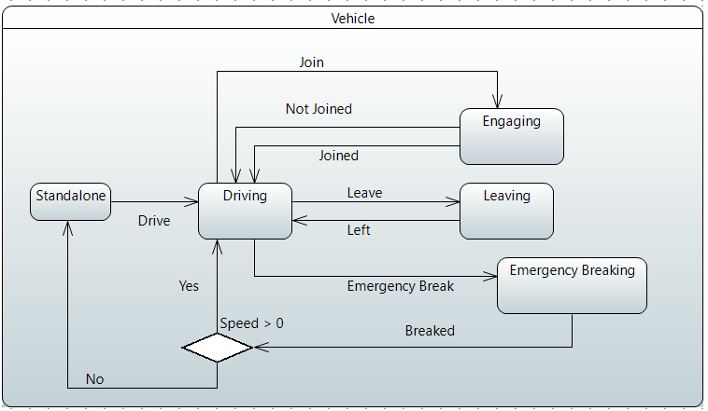
State Machines - Vehicle State

Slide 8
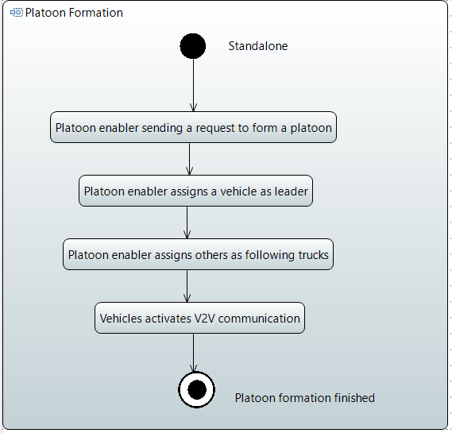
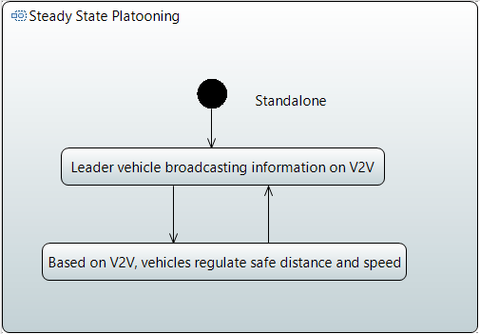
Control Behavior
Platoon Formation
Steady State Platooning

Slide 9
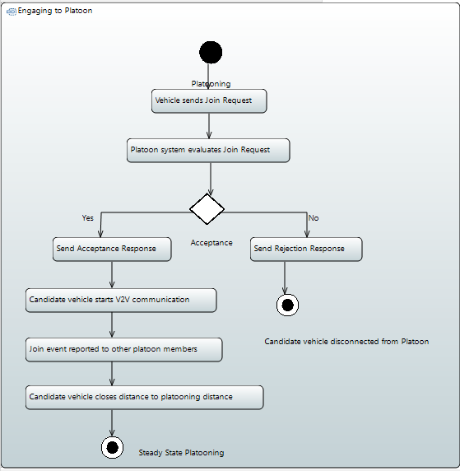
Control Behavior
Engaging to Platoon

Slide 10
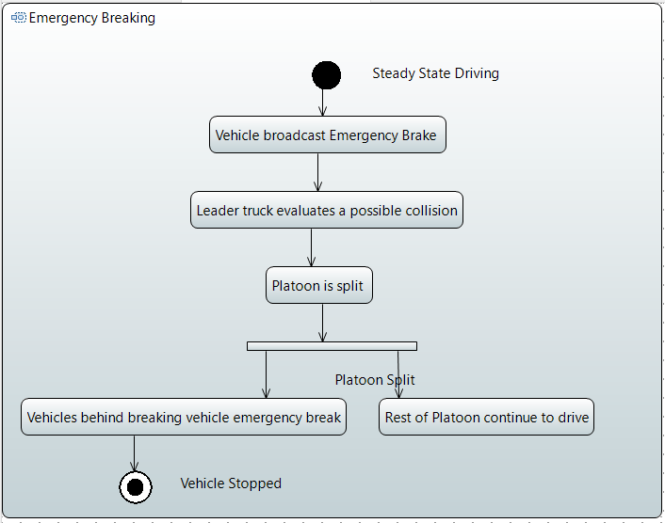
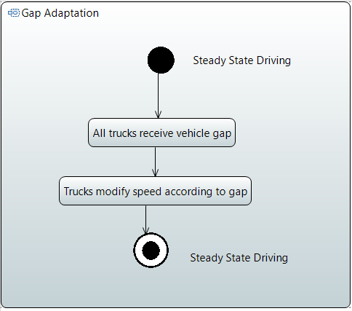
Control Behavior
Emergency Breaking
Gap Adaptation

Slide 11
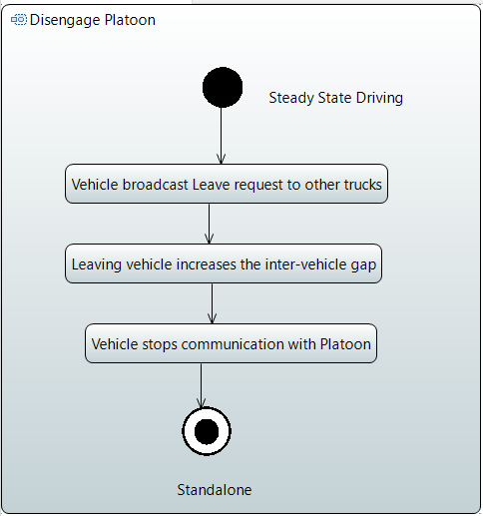
Control Behavior
Disengage Platoon

Slide 12
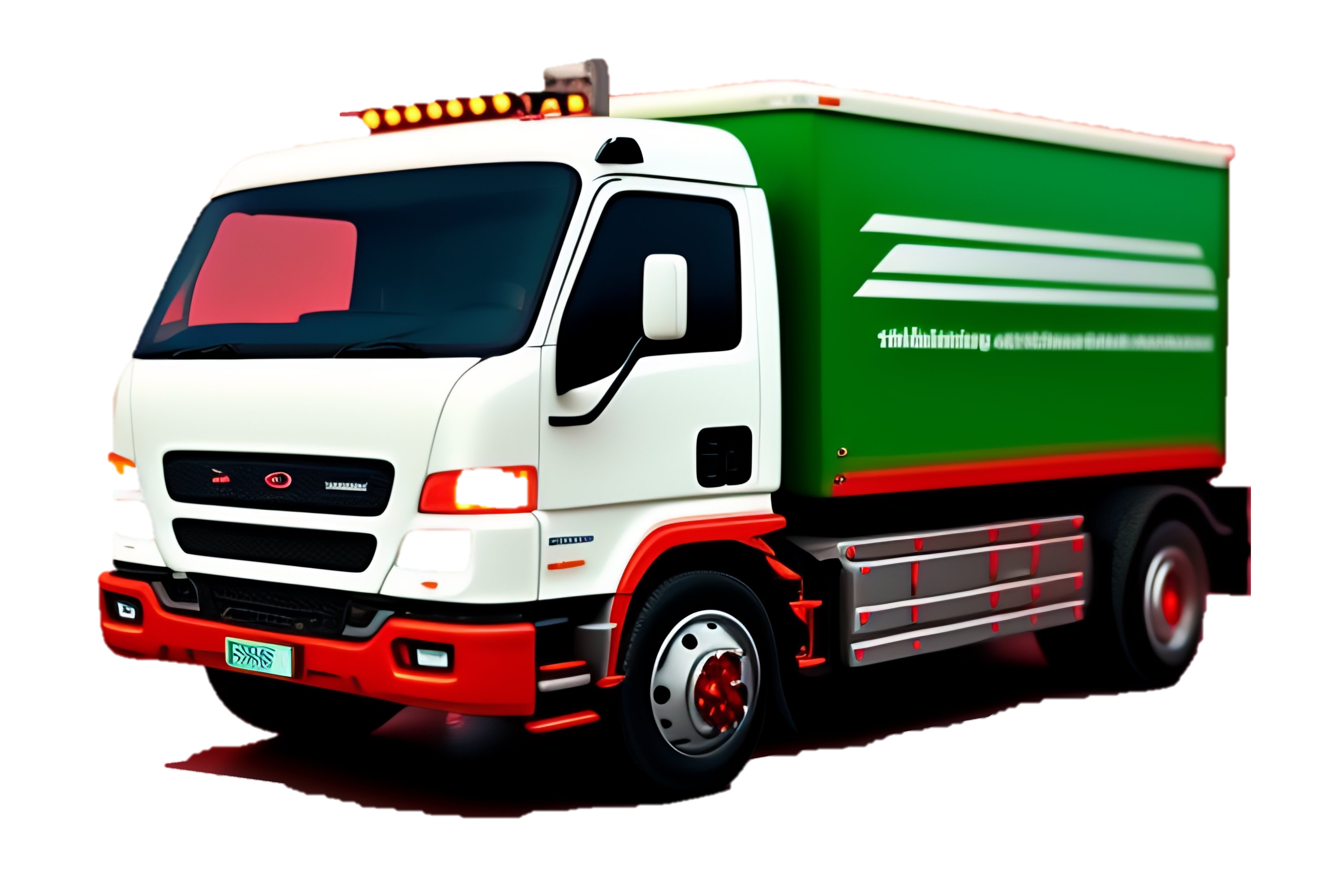




Architecture
Threading
Server
Web Sockets

Slide 13
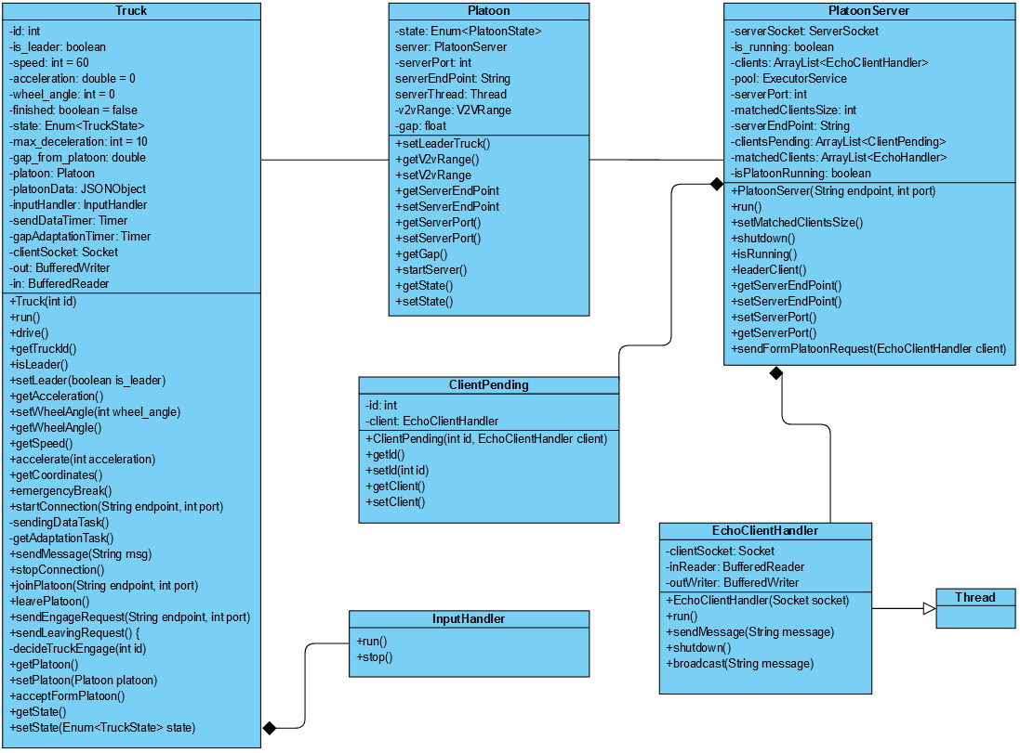
Data Model

Slide 14
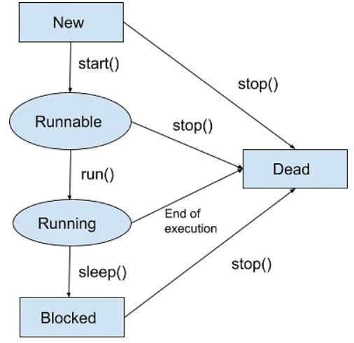
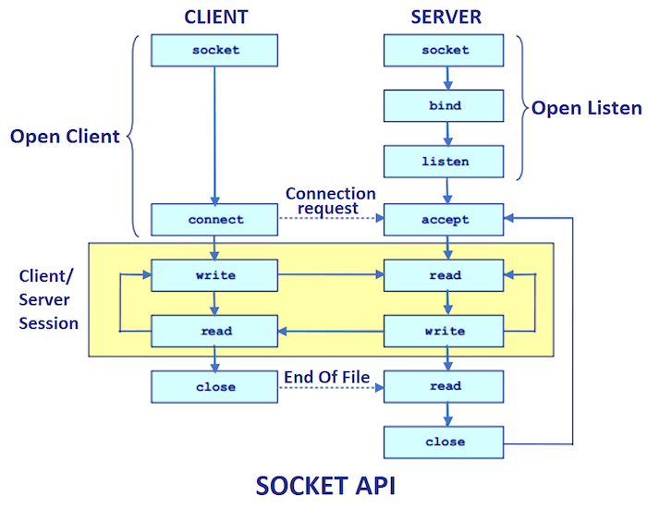

Implementation

Slide 15
Simulation - Flow
Creating Platoon and Truck instances
Starting threads of relevant instances
Matching trucks and Form Platoon
Platooning
Gap adaption of trucks
Leader truck decelerating for given seconds
Trucks joining the platoon
A truck leaving the platoon
Trucks joining the platoon
A truck emergency breaking
Leader truck accelerating for given seconds

Slide 16
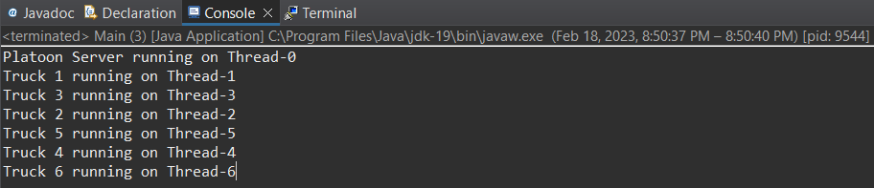
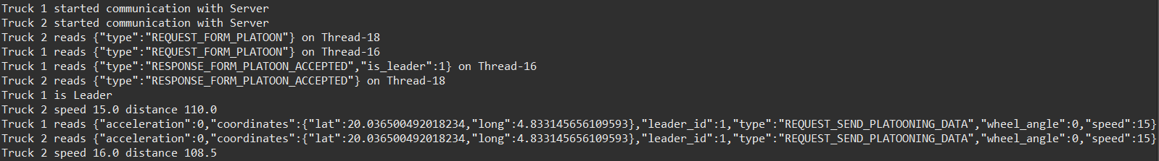
Simulation - Results
Matching trucks and Form Platoon

Slide 17
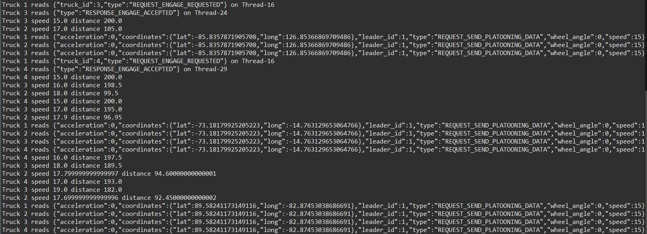
Simulation - Results
Joining the Platoon & Gap Adaptation

Slide 18
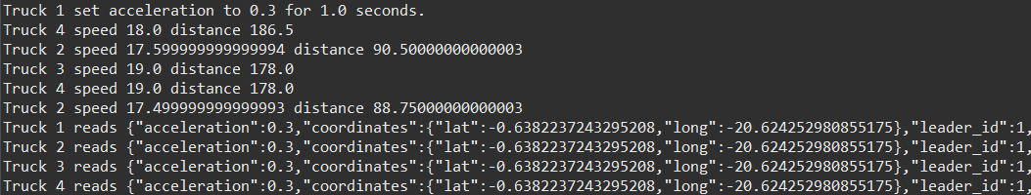

Simulation - Results
Acceleration and Deceleration

Slide 19
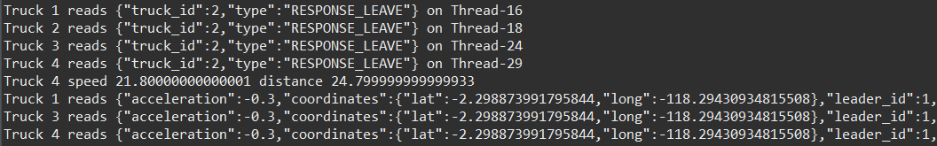

Simulation - Results
Truck leaving and other trucks joining

Slide 20
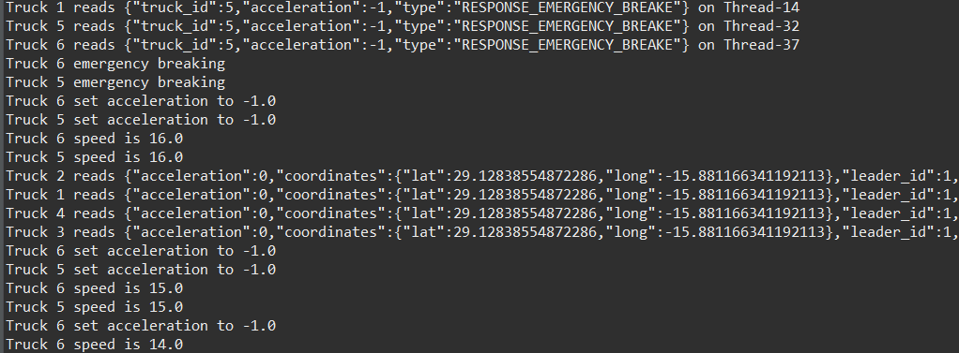
Simulation - Results
Emergency Breaking

Slide 21
Summary
The platoon formation and management algorithm is based on a leader-follower strategy
The high-level platoon use cases are outlined, and the implementation is based on the use cases
The project was implemented in Java using parallel programming
The speed and distance optimization technique use analgorithm to discover the ideal speed and distance combination for each vehicle in the platoon

Slide 22
Project source - GitHub Repository
Contact us
tural.hasanov001@stud.fh-dortmund.de
rahim.hashimov001@stud.fh-dortmund.de
seda.sensoy003@stud.fh-dortmund.de
veli.ates001@stud.fh-dortmund.de

